Slide 1
Selling HPE ProLiant Gen11 Compute
December, 2023
For more Gen11 content, including the customer presentation containing more depth on our Gen11 messaging, please check the Seismic Briefcase: HPE Next Generation Core Compute (HPE ProLiant Gen11)

Slide 2
Confidential Disclosure Agreement
The information contained in this presentation is proprietary to Hewlett Packard Enterprise and is offered in confidence, subject to the terms and conditions of a binding Confidential Disclosure Agreement (CDA)
HPE requires customers and partners to have signed a CDA in order to view this training
The information contained in this training is HPE confidential
This presentation is NOT to be used as a ‘leave behind’ for customers and information may only be shared verbally with HPE external customers under NDA
This presentation may be shared with Partners under NDA in hard-copy or electronic format for internal training purposes only
Do not remove any classification labels, warnings or disclaimers on any slide or modify this presentation to change the classification level
Do not remove this slide from the presentation
HPE does not warrant or represent that it will introduce any product to which the information relates
The information contained herein is subject to change without notice
HPE makes no warranties regarding the accuracy of this information
The only warranties for HPE products and services are set forth in the express warranty statements accompanying such products and services
Nothing herein should be construed as constituting an additional warranty
HPE shall not be liable for technical or editorial errors or omissions contained herein
Strict adherence to the HPE Standards of Business Conduct regarding this classification level is critical

Slide 3
Agenda
Connecting to customer needs
HPE ProLiant Gen11 value prop
Handling objections
Tools & resources
Appendix: Gen11 portfolio details

Slide 4
Connecting to customer needs

Slide 5
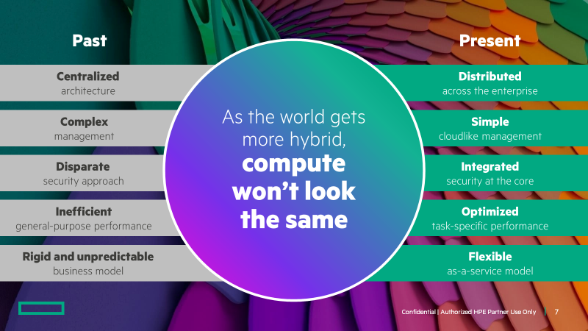
Customers are contending with new challenges
Why do HPE solutions target strategic problems and workloads?
Today, IT decision makers are responding less to the technical capabilities of solutions and more to solutions’ ability to deliver real-world outcomes for their workloads and business goals.
Legacy centralized infrastructure
Data is everywhere across a modern organization. Organizations need compute that lives where the data is stored and where it is created—without compromising manageability or security.
Operational inefficiencies and
complex management
To accelerate digital transformation, a modern compute infrastructure should be managed through an intuitive, transparent, control layer that delivers simplicity, agility, and speed.
~86%
of hiring managers believe dynamic teams of remote workers are the future.²
80%
of executives plan to apply
AI-driven automation to any
business decision.⁵
Legacy security approaches
Security risk is constantly evolving.
As digital transformation reimagines & redesigns IT infrastructure, vulnerabilities & attack surfaces can proliferate. Data-centric modernization requires a compute backbone that’s secure & hardened from the ground up.
Compute performance
Customers need compute with the power to handle huge volumes of data & power the most demanding apps/workloads, such as VDI, database, & data analytics, to support machine learning & AI initiatives.
>50%
of enterprise-managed
data will be created and
processed at the edge.⁴
20x
Likelihood that data-first
leaders will the least-advanced
beat competitors to market.³
60%
agree they have gaps
that allow attackers to
penetrate IT defenses.⁶
Business model inefficiencies
Organizations need to re-evaluate whether a CAPEX or OPEX model is right for their business.
Sustainable IT requirements & goals
Sustainable IT has become a mainstream business topic that is reshaping organizations globally, across every industry. Many businesses are setting sustainable IT goals and need to be able to track sustainability metrics.
Selling tip: Pause on this slide from the Gen11 customer deck to ask which of these points resonate with the customer.

Slide 6

HPE Core Compute
Is digital transformation a priority for you?
If yes, ask what is driving their transformation and what obstacles are they facing.
Conversation starters
What are your most important workloads?
If they mention a target workload, what are the challenges around this?
Do you have servers that are more than 5 years old?
Discuss Gen11 power/consolidation advantages
Is IT a driver of innovation and growth at your business?
If they answer no, ask about their IT challenges.
Conversation Starters
How would eliminating up-front payments IT help your business?
What would you invest in if you didn’t have to spend up-front capital on IT?
Discuss how HPE GreenLake can make this happen.
Does your IT team struggle with operational issues like firmware updates? What should they be doing instead?
Discuss how HPE GreenLake for Compute Ops Management can simplify and automate compute lifecycle management, reducing TCO.
How would your organization react if your IT infrastructure was compromised?
Discuss how HPE security innovations extend security to the partner ecosystem, the worldwide supply chain, and millions of HPE servers worldwide.
What are the biggest bottlenecks within your hybrid cloud?
Discuss how they can easily deploy a hybrid or private cloud anywhere.

Slide 7
Gen11 value proposition

Slide 8




Accelerate data-first modernization
Intuitive
Trusted
HPE ProLiant:
compute engineered for your hybrid world
Optimized
Notes:
HPE ProLiant is secure, efficient, optimized, and it’s engineered for hybrid environments. It supports distributed approaches, moving compute out of centralized datacenters and deploying it as a backbone throughout your operations—across multiple clouds, multiple datacenters and at the edge. And it’s simple to operate, with location-agnostic, cloud-based compute management ensuring visibility and consistency despite increasingly diverse compute locations and workloads: unifying operations across the lifecycle and throughout the environment, while empowering security and automation.
Compute engineered for your hybrid world.
Secure, efficient, optimized and sustainable.
Deployable as a backbone throughout your environment.
Managed through a cloud-based control layer
Available for purchase, or as a service through HPE GreenLake

Slide 9

Value Prop
Intuitive cloud
operating experience
Engineered with a cloud experience
Simplify the way you control compute from edge-to-cloud
Transform business operations and pivot your team from reactive to proactive
Benefit from global visibility and insight through a unified console
Automate tasks for efficiency, reducing manual effort in deployment, instant scalability, and seamless, simplified support and lifecycle management
Choose a capex purchase or consumption model
Key competitive differentiators
HPE GreenLake for Compute Ops Management was developed to simplify firmware management for edge use cases (in addition to servers in the data center)
Simple
Unified
Discovery Questions
Do you need to simplify server deployment?
Would you like to reduce server downtime?
Automated
Securely transform your IT focus from the manual and mundane to strategic and value-adding
Does maintaining your tools take too much time?
Are you interested in eliminating complexity and freeing up time so that you can focus on your business?
Selling tip: Use these discovery questions to connect HPE ProLiant Gen11 value to your customer’s needs
Notes:
Key takeaway: Simplify the way you control compute from edge to cloud with an intuitive cloud operating experience.
Transform business operations and pivot your team from reactive to proactive with global visibility and insight through a unified console.
The next-gen HPE ProLiant is engineered with a cloud experience, no matter if you choose a purchase or consumption model.
Business outcomes:
Modernize lifecycle management with cloud simplicity
Unify compute management with a centralized console for self-service operations
Automate tasks for efficiency, reducing manual effort in deployment, and achieve seamless, simplified support and lifecycle management.
Securely bring cloud agility to distributed compute infrastructure
Key competitive differentiators:
• Dell Apex Console does not update firmware.
• Lenovo was unclear if XClarity One could even perform global firmware updates.
• Lenovo addressed sustainability with a pay-as-you-go service utilization to help prevent over-provisioning and helps reduce energy consumption.
• Cisco Intersight is too complex for edge-specific use cases.
Discovery Questions
Do you need to simplify server deployment?
Explain how they can automatically discover and configure servers, with a low‑touch experience.
Easily onboard 1000s of distributed devices.
Reduce time to deploy.
Take a consistent, secure, governed approach.
Does maintaining your tools take too much time?
If yes, they can enjoy a consistent experience from edge to cloud, delivered for you by HPE.
Use the same tools and processes across your entire environment.
Always have the newest software version, tools, and features.
Scale instantly and massively.
How do you know your cloud data is secure?
Explain how HPE brings enterprise cloud security to wherever compute lives.
Protect identities with multifactor authentication.
Use the world’s most secure industry‑standard server platform.
Encrypt and isolate cloud data.
Would you like to reduce server downtime?
Automation can shrink maintenance windows with consistent processes reducing manual errors.
Resolve problems before they occur with self‑healing capabilities.
Automate software updates to simplify operations.
Are you interested in eliminating complexity and freeing up time so that you can focus on your business?
If yes, let them know they can manage their entire environment in real time in one place, with fewer steps.
Access up to thousands of servers across remote sites, edge systems, data centers, and hybrid cloud.
Easily integrate best‑in‑class software from HPE and partners.
Group servers and perform firmware updates in a few clicks with bulk actions.
Do you need easier firmware updates to help reduce risk?
If yes, explain how automation makes server updates faster and easier.
Update servers in a few clicks with bulk actions.
Set policies for firmware baselines and compliance.

Slide 10

Value Prop
Engineered with a fundamental security approach
Defend against increasingly complex threats
Protect infrastructure, workloads, and data from threats to hardware, and risks from third-party software
Built with a trusted edge-to-cloud security posture built on an HPE compute core hardened through a proven, zero-trust approach to security
Extending protection to partner ecosystem
Expanding trusted supply chain security
Key competitive differentiators
HPE security starts at the silicon level and extends secure supply chain to more countries than competitors.
Trusted security
by design
Fundamental
Uncompromising
Discovery Questions
What are your IT security priorities?
Where does your chain of trust begin in your current infrastructure solution building?
Protected
Deploy with confidence and have
peace of mind against security threats
How is your current infrastructure protecting you from cyberattacks?
What security measures do you take to secure you hardware and server infrastructure?
Selling tip: Use these discovery questions to connect HPE ProLiant Gen11 value to your customer’s needs

Slide 11

Value Prop
Performance to accelerate any workload from the data center to the edge
Deploy seamlessly with an open architecture
Achieve optimal performance for demanding applications requiring the most advanced graphics and data acceleration
Achieve efficiencies and performance economics to supercharge your apps and accelerate innovation everywhere your data lives
  Up to 90% better price/performance¹ compared to Gen10/Gen10 Plus
  Up to 43% reclaimed rack space² compared to Gen10
  Up to 8:1 consolidation ratio³ Gen9 to Gen11 generating
  65% power savings per year after Gen9 to Gen11 consolidation⁴
  6x better performance/Watt Gen11 vs. Gen8⁵
Optimized performance
for your workloads
Efficient
Accelerated
Discovery Questions
Do you have infrastructure that is more than
5 years old?
How could your business benefit from better efficiency?
Open
Accelerate innovation
everywhere your data lives
What workloads
are you needing
to optimize performance for?
Do you have sustainable
IT goals
you need to meet?
Selling tip: Use these discovery questions to connect HPE ProLiant Gen11 value to your customer’s needs
Notes:
Key Takeaway: HPE ProLiant Gen11 was designed to deliver the advanced performance a modern, data-centric enterprise requires.
While designing the new Gen11 servers we had three key focus areas:
First, the next generation of HPE ProLiant will deliver new levels of efficiency to power applications with the right economics for optimal business value both in the data center and across the edge.
Second, in particular, this new generation brings optimal performance for demanding applications that require the most advanced graphics and data acceleration.
Finally, we want to help you address the new wave of data center needs with an open approach. This includes delivering efficiencies for cloud-native workloads at scale and enhancing infrastructure as code - building on decades of commitment from HPE to industry standards.
Optimized performance for your workloads
Get the performance you demand to accelerate any workload —from the data center to the edge—with HPE ProLiant compute that’s engineered for your hybrid environment. Deploy seamlessly while achieving optimal performance for demanding applications requiring the most advanced graphics and data acceleration. Address new wave of data center needs with an open approach that delivers efficiencies for cloud-native workloads at scale. Achieve advantageous efficiencies spanning operational, and performance economics to power your apps and accelerate innovation everywhere your data lives.
Expect more from your infrastructure
More graphics capabilities than ever before
Advancing your most demanding workloads
Discovery Questions
Do you have infrastructure that is more than 5 years old?
By replacing older servers with HPE ProLiant Gen11, there are great consolidation possibilities, allowing customers to replace several Gen8/Gen9 servers with just 1 Gen11 server. This can provide not only price/performance improvements, but also power savings and reclaimed rack space.
Do you manage large amounts of data?
HPE ProLiant Gen11 was designed to deliver the advanced performance a modern, data-centric enterprise requires.
How could your business benefit from better efficiency?
HPE ProLiant Gen11 delivers new levels of efficiency to power applications with the right economics for optimal business value both in the data center and across the edge. Consolidate more workloads and increase ROI with breakthrough performance of next gen compute.
What workloads are you needing to optimize performance of?
HPE ProLiant Gen11 brings optimal performance for demanding applications that require the most advanced graphics and data acceleration. With up to 33% more GPU density and flexibility to optimize scale, you can power a wide range of graphics and compute use cases within the data center and at the edge for AI, ML, rendering, and data intensive applications.
Do you have sustainable IT goals you need to meet?
Decrease energy consumption and resource constraints, and optimize utilization with HPE ProLiant Gen11
SPEC and the names SPECpower_ssj and SPECrate are registered trademarks of the Standard Performance Evaluation Corporation (SPEC). The stated results are published or under review as of 06-10-2023, see spec.org. All rights reserved.
SPECrate2017_int_base: #20893, 36218, 37007, 37004 and pricing on April / June 2023.
SPECpower_ssj 2008 (same performance envelope): #1169 and 1185
SPECrate2017_int_base (same performance envelope): #36223, and 36691.
SPECrate2017_int_base (same performance envelope): #36223, and 36691, and power values estimated via HPE Power Advisor.
SPECpower_ssj 2008 (at 100% utilization): #1273 and 1274

Slide 12


Accelerate workload performance with HPE ProLiant Gen11
25%
Up to:
more performance per kW Gen11 versus Gen10 Plus³
90%
better price/performance
Gen11 versus Gen10/Gen10 Plus²
43%
Selling tip: Gen11 price/performance improvements are dependent on core count from old (previous generations) to new (Gen11). As you go up in core count, there will be improved price/performance.
reclaimed rack space
Gen11 versus Gen10 Plus¹
SPEC and the names SPECpower_ssj and SPECrate are registered trademarks of the Standard Performance Evaluation Corporation (SPEC). The stated results are published or under review as of 06-10-2023, see spec.org. All rights reserved.
SPECpower_ssj 2008 (same performance envelope): #1169 and 1185
SPECrate2017_int_base: #20893, 36218, 37007, 37004 and pricing on April / June 2023.
SPECpower_ssj 2008 (at 100% utilization): #1169 and 1185
Notes:
When comparing Gen11 to Gen10 and Gen10 Plus there are several benchmarked improvements to highlight. We have found Gen11 offers up to 43% reclaimed rack space versus Gen10 Plus and up to 90% better price performance versus Gen10 and Gen10 Plus. In addition, Gen11 offers up to 25% more performance per k/W versus Gen10 Plus.
When talking about the improved price/performance metrics for Gen11 versus Gen10 and Gen10 Plus, it is important to note that Gen11 price/performance improvements are dependent on core count from old (previous generations) to new (Gen11). As you go up in core count there will be improved price/performance.

Slide 13


Modernize workload efficiency with HPE ProLiant Gen11
Up to:
8:1
11:1
65%
6x
Gen9 to Gen11
server consolidation¹
Gen8 to Gen11
server consolidation³
power savings per year after Gen9 to Gen11 consolidation²
more performance per kW versus Gen8⁴
Selling tip: Gen8/Gen9 to Gen11 consolidation ratios can provide compelling data points for resource savings such as power usage/costs, cooling, and datacenter footprint.
SPEC and the names SPECpower_ssj and SPECrate are registered trademarks of the Standard Performance Evaluation Corporation (SPEC). The stated results are published or under review as of 06-10-2023, see spec.org. All rights reserved.
SPECrate2017_int_base (same performance envelope): #36223, and 36691.
SPECrate2017_int_base (same performance envelope): #36223, and 36691, and power values estimated via HPE Power Advisor.
SPECpower_ssj 2008 (same performance envelope): SPECpower_ssj 2008: #1273 and 1274
SPECpower_ssj 2008 (at 100% utilization): #1273 and 1274
Notes:
When talking about Gen11 versus Gen8 and Gen9 server consolidation is a beneficial point to make. We are finding a server consolidation of up to 8:1 for Gen9 to Gen11, and up to 11:1 for Gen8 to Gen11. This offers many advantages including power savings of up to 65% per year after Gen9 to Gen11 consolidation, and 6x more performance per kW versus Gen8.

Slide 14
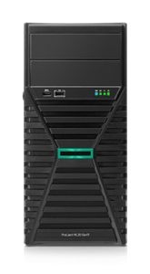
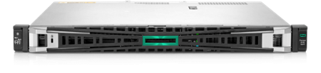
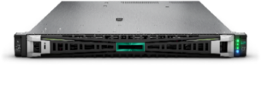
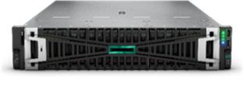
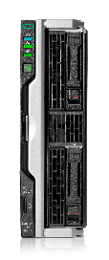
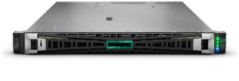
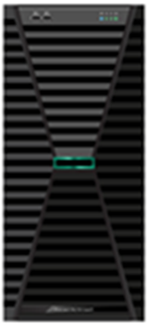
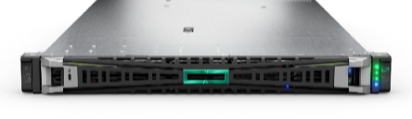
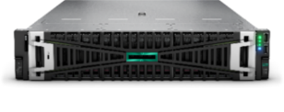
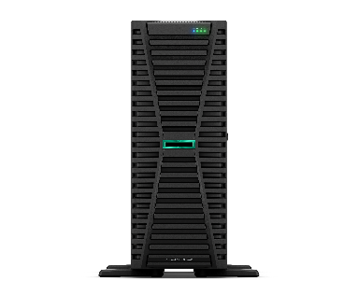
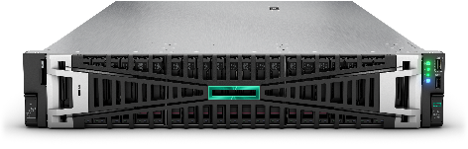
HPE ProLiant Gen11 Servers for everywhere your apps and data live
Edge optimized
Edge optimized
Density optimized
Accelerator optimized
Blade optimized
Tower, 1P
HPE ProLiant ML30 Gen11
Intel® Xeon®
E-2400 Processor
1U, 1P
HPE ProLiant DL20 Gen11
Intel® Xeon®
E-2400 Processor
1U, 2P
HPE ProLiant DL360 Gen11
4th and 5th Gen Intel® Xeon®
Scalable Processor
2U, 2P
HPE ProLiant DL380a Gen11
4th and 5th Gen Intel® Xeon®
Scalable processor
Blade, 2P
HPE Synergy 480 Gen11
4th and 5th Gen Intel® Xeon®
Scalable Processor
1U, 1P
HPE ProLiant DL320 Gen11
4th and 5th Gen Intel® Xeon®
Scalable Processor
Tower, 1P
HPE ProLiant ML110 Gen11
4th and 5th Gen Intel® Xeon®
Scalable Processor
Cloud optimized
1U, 1P
HPE ProLiant RL300 Gen11
Ampere® Altra® and Ampere® Altra® Max
2U, 2P
HPE ProLiant DL380 Gen11
4th and 5th Gen Intel® Xeon®
Scalable Processor
Big Data optimized
2U, 4P
HPE ProLiant DL560 Gen11
4th and 5th Gen Intel® Xeon®
Scalable Processor
4U, 2P
HPE ProLiant ML350 Gen11
4th and 5th Gen Intel® Xeon®
Scalable Processor

Slide 15




HPE GreenLake for Compute Ops Management (COM)
Unified Compute Management: Real-time management and device onboarding
Act Faster
Manage Your
Entire Experience
Get To Market Sooner
Add 1,000s of devices easily
Real-time management
your entire environment
Easy onboarding for
distributed deployments
Use one console
Remote sites, edge systems, data centers, hybrid cloud
Access 1,000s of compute devices from anywhere
Multi-device, multi-site views
Instant access to new updates
Cloud-native platform
Scale elastically
with SaaS delivery
Notes:
COM supports up to 50,000 servers

Slide 16
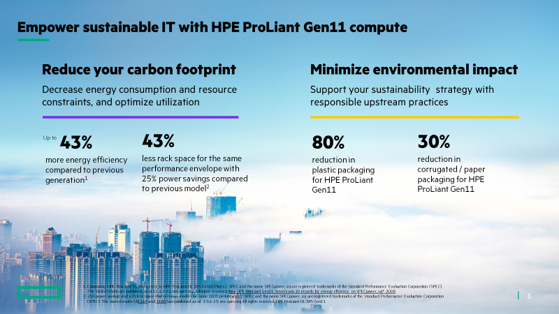
Empower sustainable IT with HPE ProLiant Gen11 compute
Discovery Questions
Are you trying to reduce energy use, especially in your data center or IT infrastructure workspaces?
Do you need to be able to track IT energy usage and your carbon footprint?
Do you think infrastructure management (admin, maintenance, physical/ firmware updates)
should be easier?
What is your product
end-of-life strategy?
Selling tip: For customers that are concerned about sustainable IT, point out the cost of doing nothing. Retiring older servers and replacing with Gen11 can help decrease energy consumption and resource constraints, reduce carbon footprint, optimize utilization, and gain investment capacity.
Selling tip: Use these discovery questions to connect HPE ProLiant Gen11 value to your customer’s needs
Notes:
HPE Sustainable IT Discovery Questions:
Are you trying to reduce energy use, especially in your data center or IT infrastructure workspaces?
HPE ProLiant Gen11 servers offer up to 43% more energy efficiency¹ and up to 99% improved performance² compared to previous generations to help lower energy consumption and reduce server footprints.
Do you need to be able to track IT energy usage and your carbon footprint?
HPE GreenLake for Compute Ops Management gives global visibility and insight across all compute devices across sites and deployment locations, including new sustainability insights with Carbon Footprint reports
Do you think infrastructure management (admin, maintenance, physical/firmware updates) should be easier?
HPE GreenLake for Compute Ops Management helps increase operational efficiency through secure automation of key processes.
Do you have a plan to consolidate your multi-gen IT environment?
Migrating to HPE ProLiant Gen11 and consolidating older IT can help your business decrease energy usage and reduce your carbon footprint. HPE ProLiant Gen11 servers utilize up to 42% less rack space for the same performance envelope with 25% power savings compared to previous models³.
What is your product end-of-life strategy?
HPE can help you upcycle your IT and find untapped value in your IT estate. >2.3M server assets have been given a second life over the last 3 years, with customers getting $1.3M back every working day in 2022⁴.
Comparing HPE ProLiant DL385 Gen11 to HPE ProLiant DL385 Gen10 Plus v2. SPEC and the name SPECpower_ssj are registered trademarks of the Standard Performance Evaluation Corporation (SPEC). The stated results are published as of 11-10-22; see spec.org. All rights reserved.
Compared to previous generation. SPEC and the names SPEC CPU, SPECrate, SPECspeed are registered trademarks of the Standard Performance Evaluation Corporation (SPEC). The stated results are published as of 11-10-22; see spec.org. All rights reserved.
25% power savings and 43% less space that previous model (for same 100% performance): SPEC and the name SPECpower_ssj are registered trademarks of the Standard Performance Evaluation Corporation (SPEC). The stated results (#1169 and 1185) are published as of 2-16-23; see. spec.org All rights reserved. HPE ProLiant DL385 Gen11
HPE Technology Renewal Center FY2022 Data Report

Slide 17
Is HPE ProLiant Gen11 the right fit?
Find out with 2 simple questions
What is most important to the customer?
Choose 1: Best price/performance and/or high performance OR lowest acquisition price?
Best price/performance and/or
high performance is most important
Performance is most important for
Demanding workloads: AI/ML, VDI, Data Analytics, & Data Solutions
Certain Segments: finance, healthcare, media & entertainment
Customers concerned about performance headroom for the future
Lowest acquisition price
is most important
Lowest acquisition price may be especially important for SMBs
Ask
Do they need to continue to purchase the
same configuration past end of 2023 (Gen10) or mid 2024 (Gen10 Plus)
Recommend
HPE ProLiant Gen11
Gen11 compared to Gen10 Plus:
Up to 24% price/performance benefits for VMware customers
Accelerate performance of workloads like VDI, data solutions, and compute for AI: 2.25X more memory bandwidth with high performance DDR5 memory
Accelerate GPU, storage, and network-intensive workloads: PCIe Gen5 provides more lanes for improved GPU, storage, and network performance; increased GPU density
Power efficiency: Up to 43% more power efficient
If yes, recommend
If no, recommend
HPE ProLiant Gen10 / Gen10 Plus / v2
For workloads that benefit from increased performance (e.g., Hybrid Cloud & Containers), Gen10 Plus may offer better price/performance vs Gen10
NOTE: HPE does not recommend customers consider Gen10 / Gen10 Plus / v2 for new projects given the anticipated EOL timeframes for those platforms
  e.g., End of Sales for HPE ProLiant DL360/DL380 Gen10 is 4/30/2024

Slide 18
Handling objections

Slide 19
Handling key objections
I need to update my servers, but I cannot afford Gen11.
If you need more than a few servers, there is a good chance you will need fewer Gen11 servers to replace your current infrastructure because of Gen11 vs. Gen10 consolidation. Gen11 offers improved price/performance in many cases. In addition, HPE GreenLake and HPE Financial Services can the flexibility to choose where and how you consume your compute to best fit your business and budget.
We’re going straight to cloud.
Have you seen recent reports that after the first wave of digital transformation, around 67% organizations consider hybrid cloud is a permanent strategy because specific workloads aren’t suitable for public cloud? ¹ With HPE you can easily deploy a secure and scalable hybrid cloud anywhere you need it, so you can always place workloads in the optimal environment.
We’ve got everything we need; we just need to optimize.
Does your existing infrastructure have the performance, automation, and security to optimize workloads in a way that will give you a competitive edge and accelerate your digital transformation? HPE Core Compute solutions are optimized for today’s most demanding workloads and designed for the next wave of digital transformation (DX).
I’m concerned about the power requirements of Gen11 and sustainability.
Migrating to HPE ProLiant Gen11 can actually help decrease energy consumption, resource constraints, and your carbon footprint. HPE wants to help customers minimized their environmental impact and support their sustainable IT strategies with responsible upstream practices.
We don’t have the budget.
You can pay as you use, with no up-front payment, with HPE GreenLake. If your infrastructure is out of warranty, you might be paying more for support than you need to – and TCO could actually be lower with a new solution.
What we’ve got is fine for what we need.
If you are planning to grow your business, would it help to start using servers that can help you achieve your goals? With HPE you can start small with a right-sized solution then scale as you grow. You will also gain trusted security that protects your firmware and third-party components.
We’re happy managing our existing servers and are too busy just keeping the lights on.
You may be getting the best from your servers now, but doesn’t managing them still take time? With HPE GreenLake for Compute Ops Management you have one seamless management experience that simplifies provisioning, automates key tasks, and is managed for you. You can streamline with a single console experience from edge-to-cloud, with self-service and real-time access to servers. Simplify and automate to reduce your TCO. And secure cloud operations and distributed compute tasks, using a cloud-native architecture.
Notes:
1. “Hybrid Cloud Adoption Survey,” Hornetsecurity, March 2022 https://www.hornetsecurity.com/us/security-information-us/hybrid-cloud-adoption-survey/

Slide 20
Tools & resources

Slide 21
Gen11 competitive resources
Competitive data is constantly changing and evolving. To ensure you have the latest competitive information, please utilize these sources where you can find the newest assets including presentations, announcements, data sheets, and more.
Competitive Asset Repositories- Where to find HPE competitive assets
HPE ProLiant Gen11 Competitive Resources- Competitive Insights: This living document will be frequently updated and is single source for all Gen11 Competitive documents
HPE Competitive Seismic briefcase
HPE Competitive Intelligence Portal
Key Competitive Assets
Competitive Battlecard
Competitive Presentation
Competitive Positioning “How we stack up”
Datasheet examples (more datasheets included in the Competitive Resources document & Portal listed above)
  HPE ProLiant DL360 Gen11 vs. Lenovo ThinkSystem SR630 V3 CDS
  HPE ProLiant DL365 Gen11 vs. Lenovo ThinkSystem SR645 V3 CDS
  HPE ProLiant DL380 Gen11 vs. Dell PowerEdge R760 Competitive Data Sheet
  HPE ProLiant DL380a Gen11 vs. Dell PowerEdge R750XA Competitive Data Sheet

Slide 22


Gen11 OCA Smart Templates
OCA Smart Templates for key Gen11 platforms reduce the complexity of creating configurations in OCA
OCA Smart templates are named UCID configurations that have been vetted with no click-rule errors
It is an easy way to get to a valid starting config without worrying about some of the complexities (E.G., backplanes, cables, controllers). You can then customize further to meet your specific requirements.
How to get to OCA Smart Templates
Launch OCA
Select the desired CTO Gen11 platform (E.G., DL380 Gen11 8SFF)
Click “Create”
Once in the One Config Advanced screen, click on “Smart Templates”
From list, select desired template and click “Apply”
Start editing components to meet your requirements

Slide 23
Tools
HPE TCO/ROI Business Value Calculator for ProLiant & Synergy & Power Advisor
HPE TCO/ROI- Business Value Calculator
What products does it cover? HPE ProLiant, HPE Synergy
Target Users Sales version: HPE employees and HPE approved partners via SSO or HPE passport logins, respectively
What does the tool provide the user? Users can perform a total cost of ownership (TCO) and/or Return of Investment (ROI) analysis of HPE products vs competition using multiple tools
  A brownfield or a greenfield comparison can be done, if available
https://mainstayadvisor.com/signin.aspx?t=HPE
HPE Power Advisor
What is HPE Power Advisor? A proprietary tool used globally to calculate the power consumption of unique customer configurations—at a server, rack, and multi-rack level—developed by HPE
What does the tool provide the user? Provides power estimations & logic on Gen10, Gen10 Plus, and Gen11 platforms along with compatible options and current rules and configurations
https://www.hpe.com/info/poweradvisor

Slide 24
Resources
Gen11
Consumption models
HPE Next Generation Compute (HPE ProLiant Gen11) Briefcase
Play Book—HPE Core Compute
HPE GreenLake Seismic briefcase
HPE GreenLake & HPE Core Compute
HPE Financial Services Seismic briefcase
Infrastructure
Software
HPE Compute Portfolio Briefcase
HPE ProLiant Servers Portfolio Briefcase
HPE Synergy Seismic Briefcase
HPE OneView Seismic briefcase
HPE Ezmeral Runtime Enterprise Seismic briefcase
Options
Services
HPE Compute Security Seismic briefcase
HPE Pointnext Services Seismic briefcase
Perfect Attach from HPE Pointnext Services Seismic briefcase
HPE GreenLake for Compute Ops Management (COM)
Competitive
HPE GreenLake for Compute Ops Management briefcase
Sales Presentation – HPE GreenLake for Compute Ops Management
Playbook- HPE GreenLake for Compute Ops Management
Training - What is HPE GreenLake for Compute Ops Management
HPE Competitive Seismic briefcase

Slide 25
Thank You
a00127630enw

Slide 26
Appendix: Gen11 portfolio details

Slide 27
HPE leadership for performance and efficiency
3 for enterprise server-side Java
4 for artificial intelligence
42
5 for content apps
6 for data management
world records
6 for cloud and virtualization
7 for big data
11 for energy efficiency

Slide 28
HPE GreenLake for Compute Ops Management
New Features Across All Categories
Server deployment
OS image deployment
Lifecycle management
iLO remote console
Enhanced firmware update automation
Analytics & sustainability
Enhanced carbon footprint reports
Governance
& policy
IAM
Scope-based access controls
Monitoring & support
Auto case creation
Email notifications for critical alerts
Server health status report
Security
Secure mTLS connections from iLO to cloud
End-to-end security from device to application
Integrations
VMware vCenter*
ServiceNow
  *Tech preview available now
HPE ProLiant DL/ML servers | HPE Alletra 4000 storage system | HPE Edgeline EL8000⁺
  ⁺Monitoring support available now
Notes:
Intent of Slide: Show COM’s seven feature themes
The pillars at the foundation of Compute Ops Management – automated, security, unified management, and simplicity – map to 7 important customer capabilities.
These 7 capabilities are also the key investment areas for the development of Compute Ops Management. Customer benefits, features, and improvements are delivered in each area.
Latest feature list can be found at: hpe.com/psnow/doc/a50006391enw

